Slide 1
Lambda,Map,Filter,Reduce
Generators & Iterators

Slide 2
Lambda
Generally in Python we will define a function using def keyword .
but this lambda functions doesn't contain any def keyword .
So the syntax of lambda function is,
lambda argument list:expression.

Slide 3
we can see the advantage of the lambda function when it is used with the some built in functions like map reduce filter.
Map:-
map is the built-in function, and this function is used to apply a function to all the element of a sequence.
syntax is,
map(function,sequence)

Slide 4
Filter
we can see the advantage of the lambda function when it is used with the some built in functions like map reduce filter.
filter function will filter the element of the iterables based on some function.
syntax is filter(function,iterable)
this is an inbuilt function so it is faster.

Slide 5
Reduce
reduce function will reduce a iterable to single element using some functions, this function can be used when we want to do some computation on list or tuple.
syntax is reduce(function,iterable)
In python 3 reduce function is defined in functools module, so to use reduce function we need to import that module.

Slide 6
What is Generator
Generator functions is a function which returns generator-iterator with the help of yield keyword.yield works like return in normal functions.
Generator function has the same syntax like normal function only difference is it contains yield keyword in function body.

Slide 7
iterables and iterators
Here we will discuss how for loop works internally.And about iterables and iterators.Everything we can loop over is called as iterables like list tuples strings sets and dictionaries.And iterables will give iterators . An iterator is an object that implements next. next is expected to return the next element of the iterable object that returned it, and raise a StopIteration exception when no more elements are available.

Slide 8
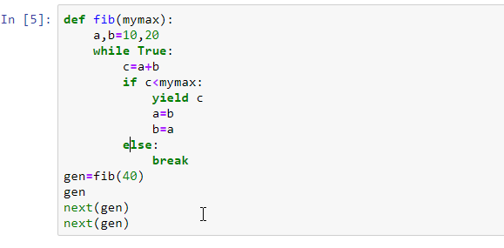
Generator Example

Slide 9
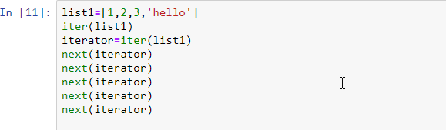
Example

